Slide 1
How to use this Mother’s Day table tent template
Tools you'll need:
PowerPoint or Google Slides
5X7” table tent stand
Step 1 - Open the template
The original template is in PowerPoint format, but you can also use Google Slides to open the file and make edits.
Step 2 - Customize the text
Your table tent is located on Slide #3. Use the provided text fields to customize the message.
Step 3 - Check your work
We've included an example of a finished table tent on Slide #2. Use this slide as a reference to check your work.
Step 4 - Print/Upload and display
You can print your table tent for in-store promotion, or upload it as a PDF to your website.
Step into the spotlight with ChowNow
ChowNow puts your restaurant front and center with online ordering and marketing tools that help you take orders from anywhere, show off your brand, and optimize operations. Get a taste of what we have to offer by speaking to an expert.
With ChowNow, you’ll be able to:
Generate more profit
Own your digital dining experience
Reach more diners wherever they are
Make every customer a regular
Visit ChowNow.com to learn more.

Slide 2
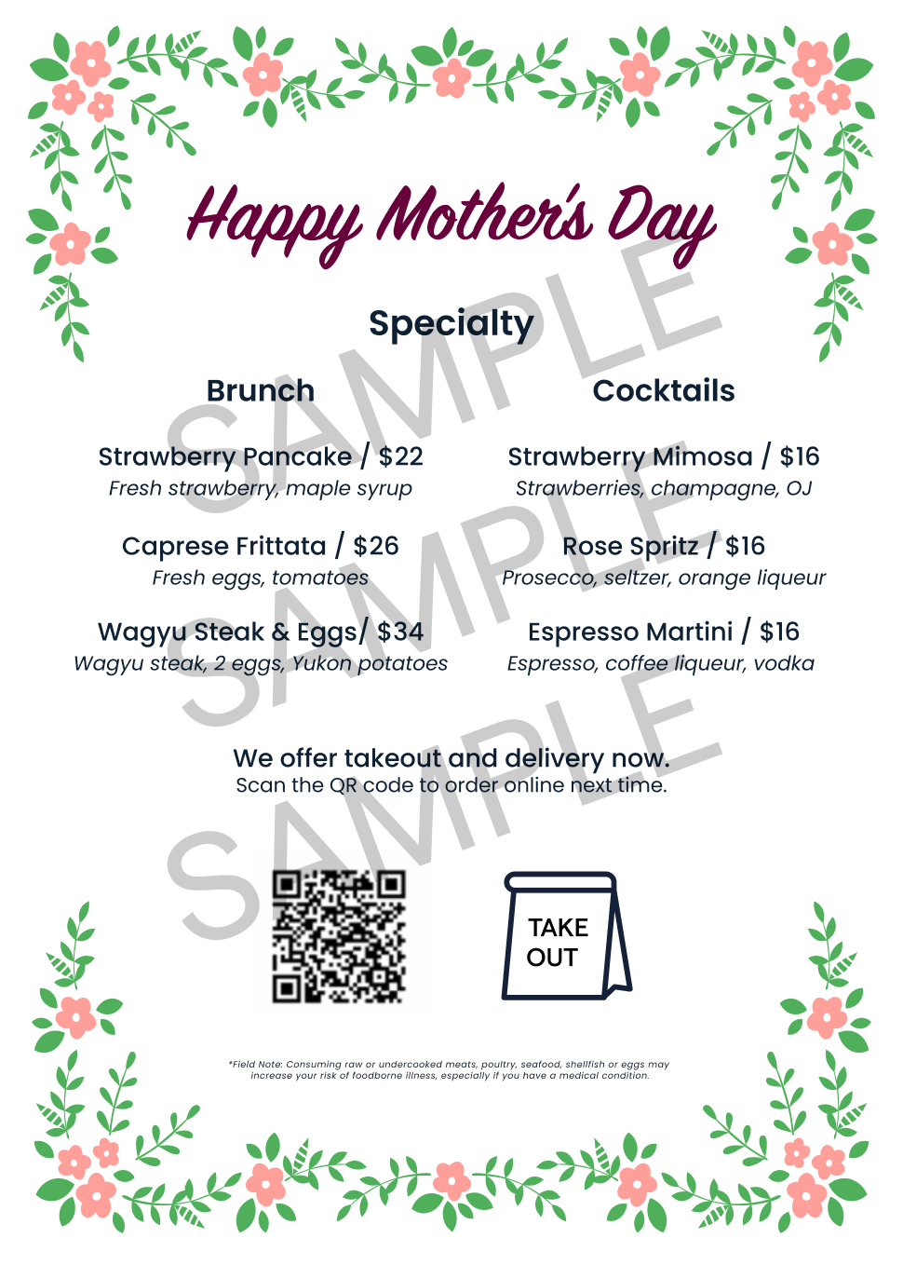

Slide 3
Menu Section
Menu Item / Price
Item Description Goes Here
Menu Item / Price
Item Description Goes Here
Menu Item / Price
Item Description Goes Here
Menu Section
Menu Item / Price
Item Description Goes Here
Menu Item / Price
Item Description Goes Here
Menu Item / Price
Item Description Goes Here
Specialty
We offer takeout and delivery now.
Scan the QR code to order online next time.
* Example: Consuming raw or undercooked meats, poultry, seafood, shellfish or eggs may
increase your risk of foodborne illness, especially if you have a medical condition.

